Slide 1
NeverEatAlone
EN.600.421 Object-Oriented Software Engineering Group 19: Project Overview December 17, 2014
Yueling Loh, Tejasvam Singh, Hai Tang Runze Tang, Xiaozhou Zhou

Slide 2
Goal of the App
A simple centralized way to connect people with their friends to meet up for food
Mobile, for easy access
Motivated by the same old process of gathering people in the department for lunch every day

Slide 3
Major Features
Create, update and delete account
Login and log out
Send friend request and add friends
As an inviter:
Send meal invitation to selected friends
Can broadcast the notification to all friends
As a recipient
Receive push notifications of invites
Accept, decline or ignore the invitation

Slide 4
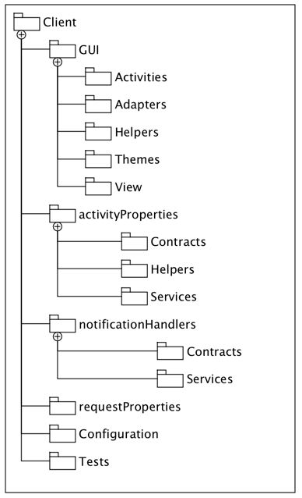
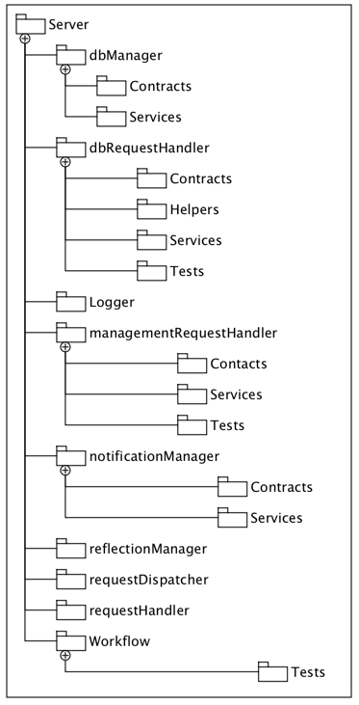
Overall Package Diagram

Slide 5
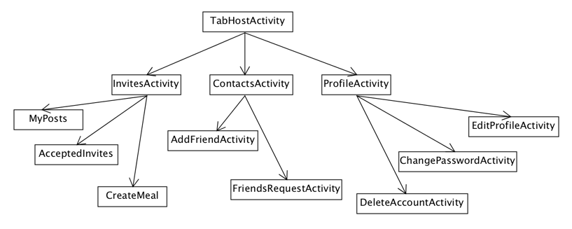
Selected Class Diagrams

Slide 6
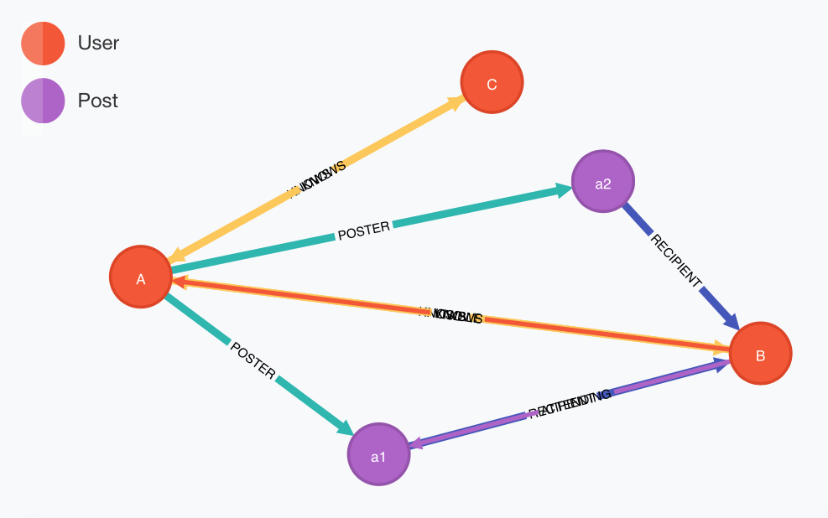
Database Structure

Slide 7
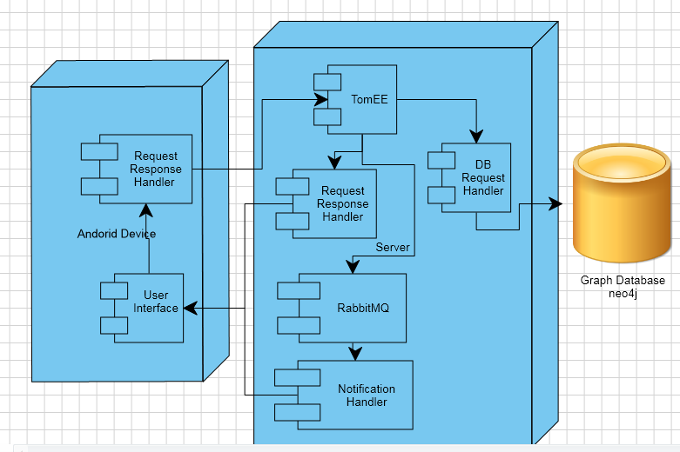
Deployment Diagram

Slide 8
Demonstration
Questions?

